Slide 1


AFIRE Sprint on AI in Grantmaking
2025-11-12
https://researchonresearch.org/project/a-f-i-r-e/

Slide 2
Start recording

Slide 3

Welcome From James Wilsdon
Executive Director, RoRI
James was one of the founders of RoRI and has been its director since 2019. He is also Professor of Research Policy at University College London (UCL), based in its Department of Science, Technology, Engineering & Public Policy (STEaPP). Since the late-1990s, as a researcher, writer, adviser and campaigner, James has worked at the heart of science and research policy in the UK and internationally.

Slide 4

RoRI’s Mission & Objectives
Mission: to accelerate transformative research on research systems, cultures and decision-making
Objectives:
Boosting capacity for transdisciplinary, collaborative, applied and mixed-method research on research
Building infrastructures to connect academic capabilities to the data and analytical resources of research funding organisations
Experimenting with new tools, indicators, methods and evaluation frameworks
Accelerating the translation and uptake of metascientific evidence by decision-makers
Enabling networking, co-design and collaboration between meta-researchers, funders, policymakers, publishers, data and infrastructure providers
19 core partners (public & private funders; Digital Science; CWTS; UCL)
‹#›

Slide 5


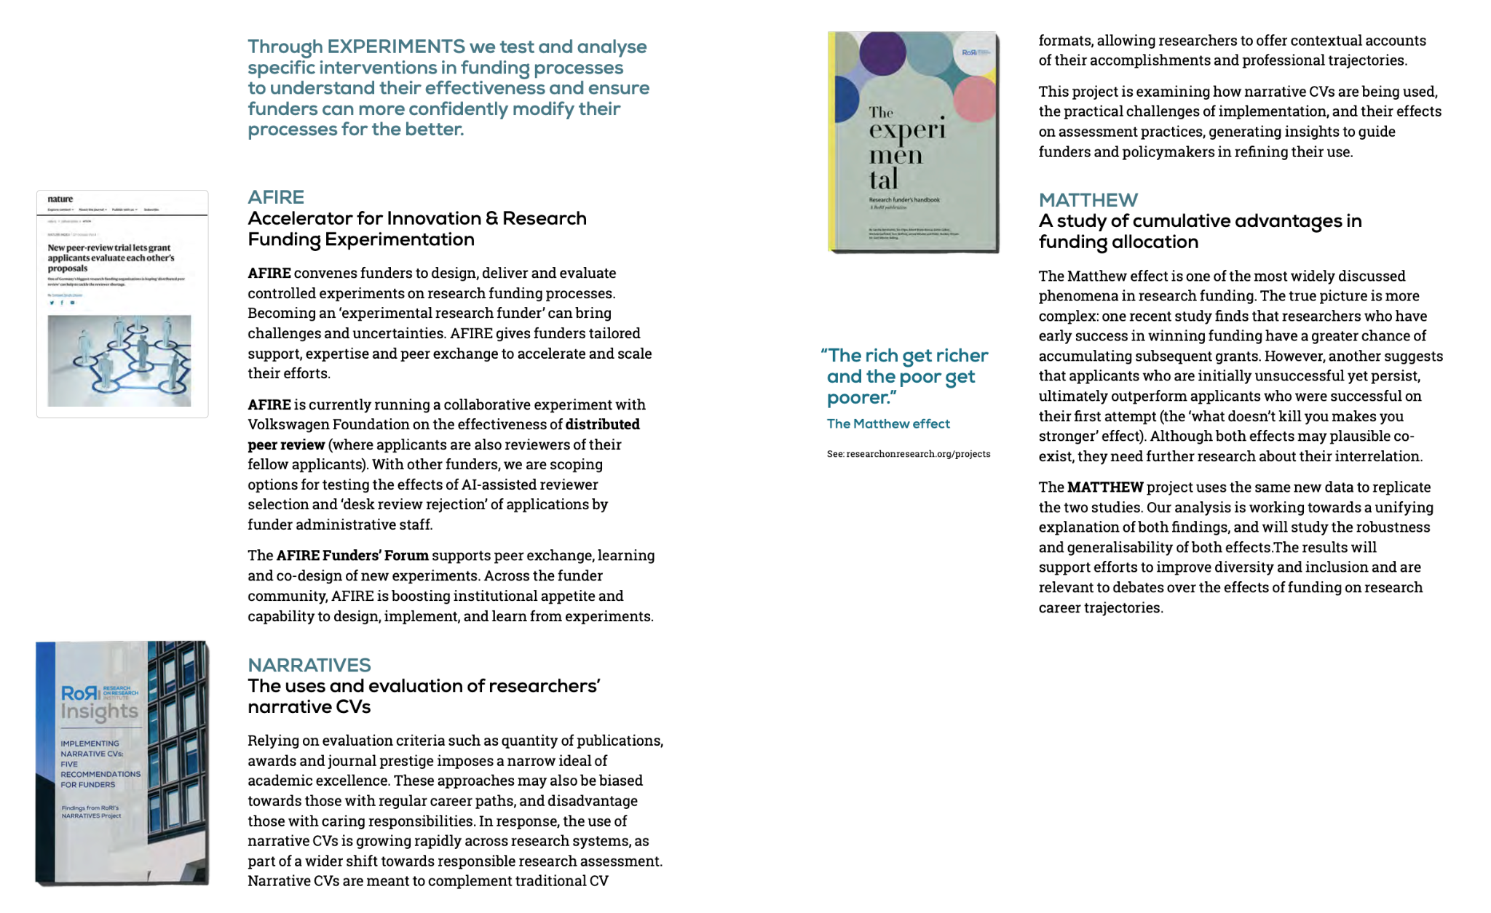
RoRI Outputs
“…generating insights to guide funders and policymakers in refining their use.”
“The results will support efforts to improve diversity and inclusion and are relevant to debates over the effects of funding on research career trajectories.”
‹#›

Slide 6
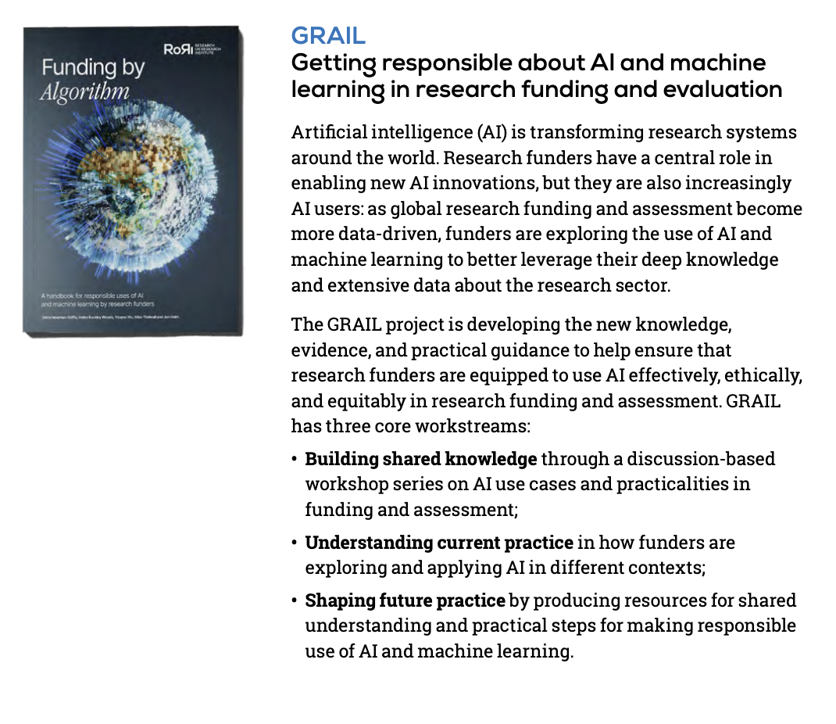

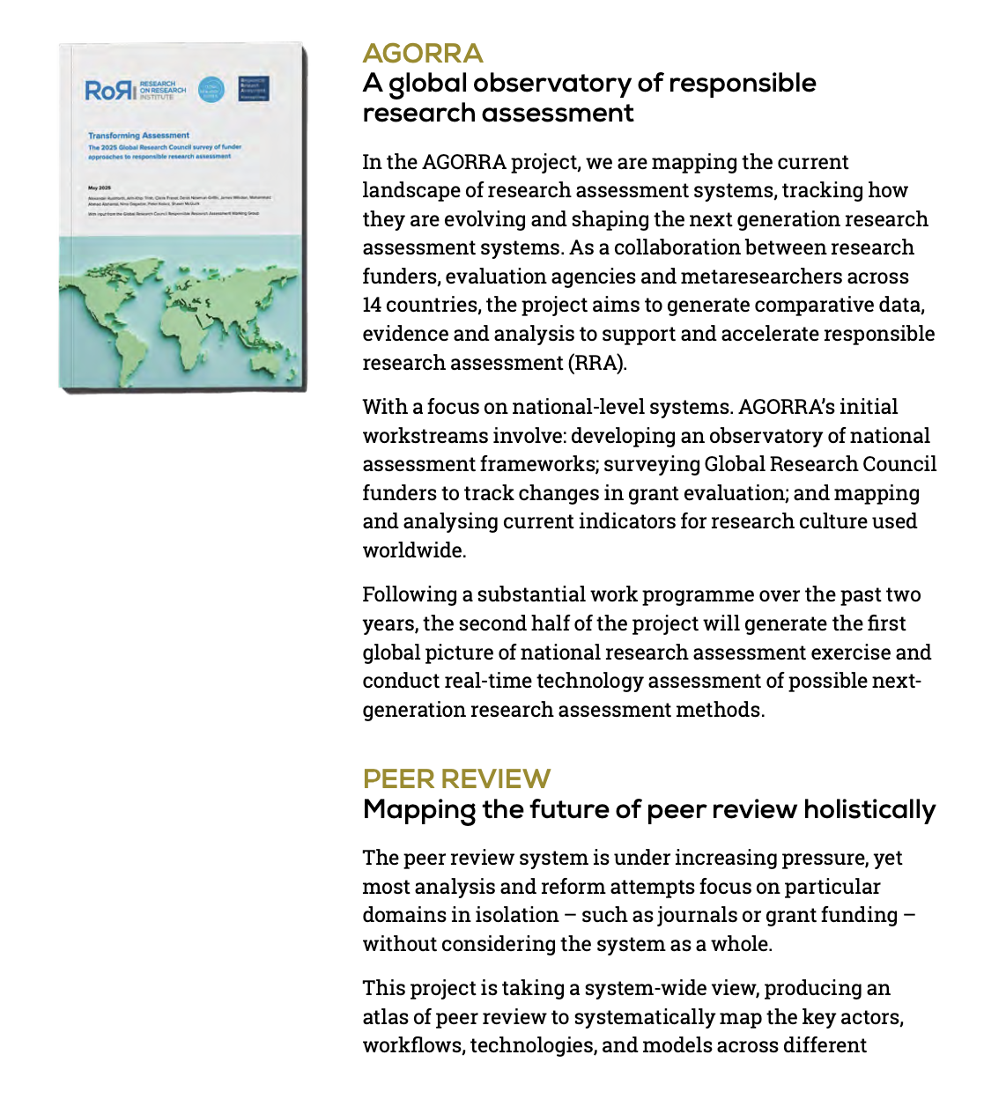
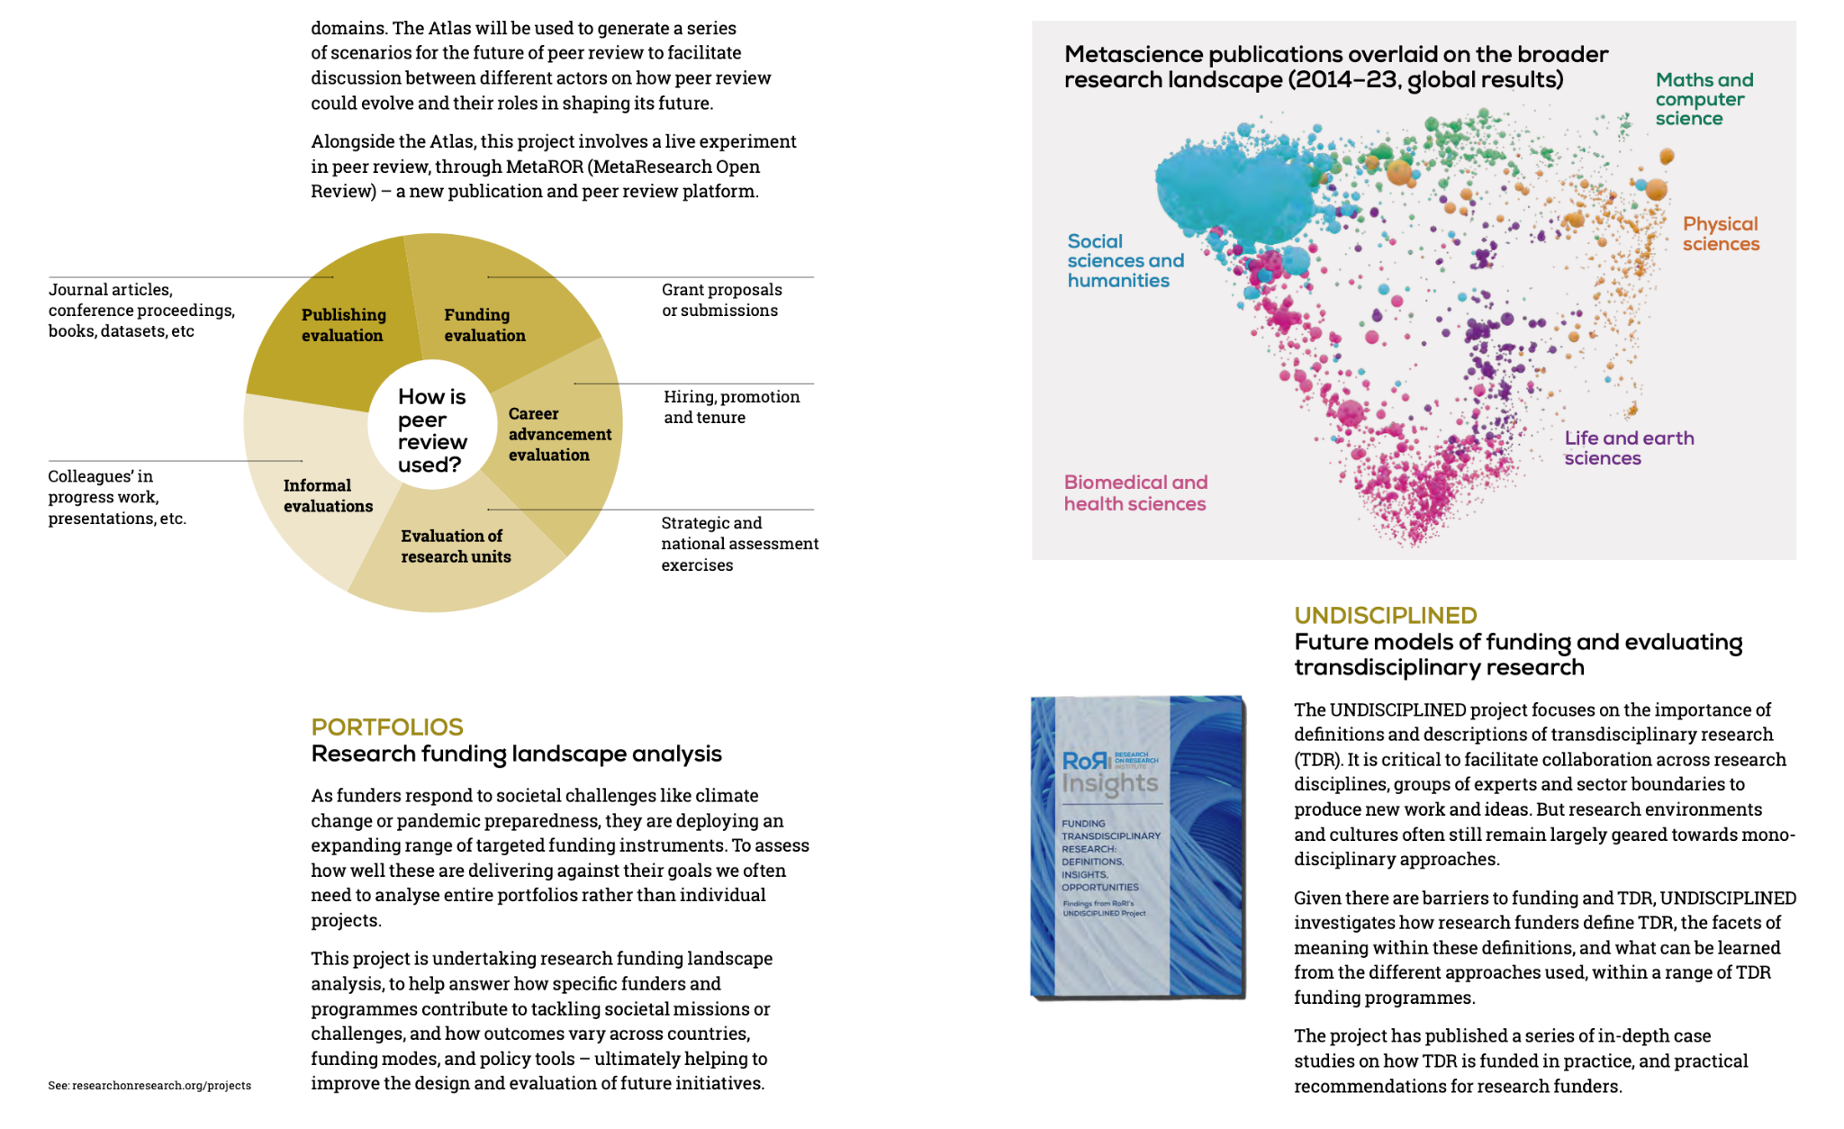
RoRI Outputs
“…developing new knowledge, evidence and practical guidance to help ensure that funders are equipped to use AI effectively, ethically and equitably…”
“ultimately helping to improve the design and evaluation of future initiatives.”
‹#›

Slide 7

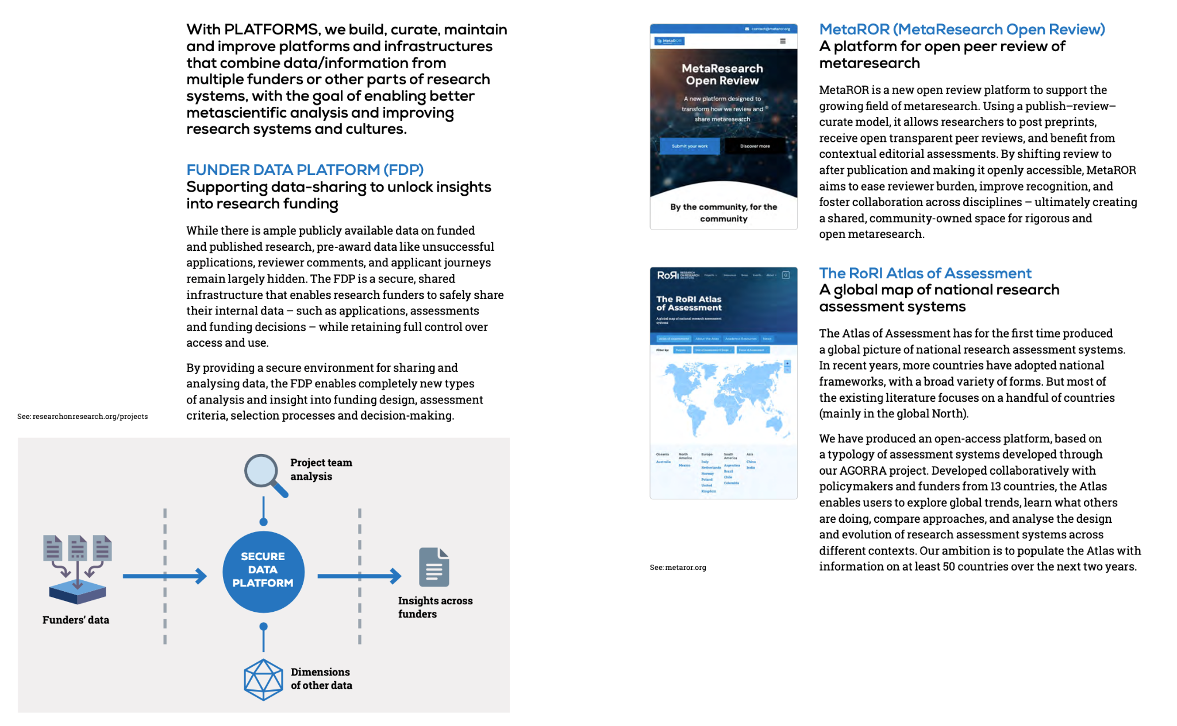
RoRI Outputs
“the Atlas enables users to explore global trends, learn what others are doing, compare approaches, and analyse the design and evolution of research assessment systems across different contexts.”
“the FDP enables completely new types of analysis and insight into funding design, assessment criteria, selection processes and decision-making.”
‹#›

Slide 8

The Research on Research Institute Impact Report (2023-2025)
https://researchonresearch.org/roris-impact-what-weve-achieved-and-where-were-going/

Slide 9
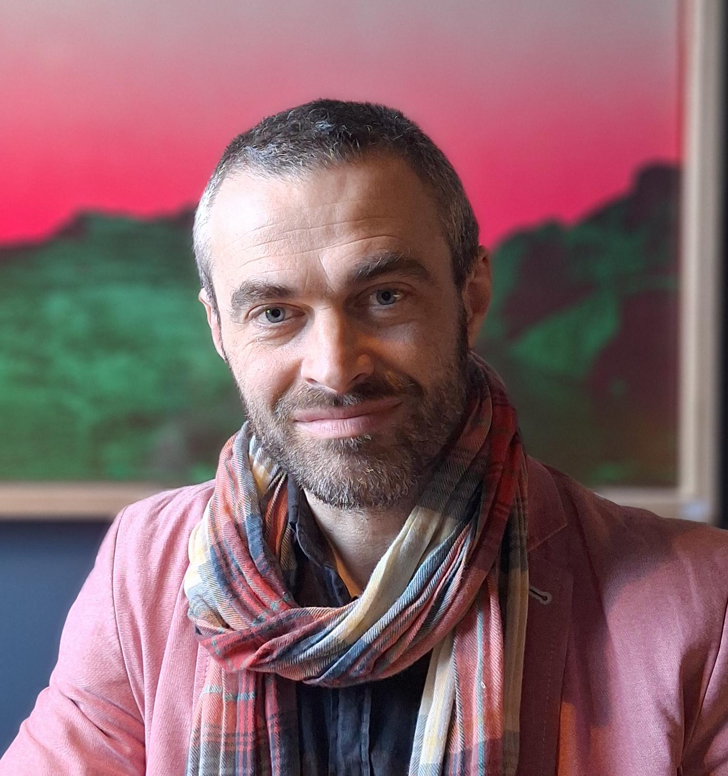
Welcome From Tom Stafford
Professor of Cognitive Science
& University Research Practice Lead
University of Sheffield
https://tomstafford.github.io/
Senior Research Fellow,
Research on Research Institute
https://researchonresearch.org/

Slide 10

AFIRE: Accelerator for Funder Experimentation
Forum
Sharing work by funders, for funders
Capacity building
Sprints on AI/ML in reviewer selection
Experiments
Distributed Peer Review, Partial Randomisation, Desk Rejection, and more!
These slides:
bit.ly/tomstafford
https://researchonresearch.org/project/a-f-i-r-e/
https://researchonresearch.org/project/a-f-i-r-e/

Slide 11
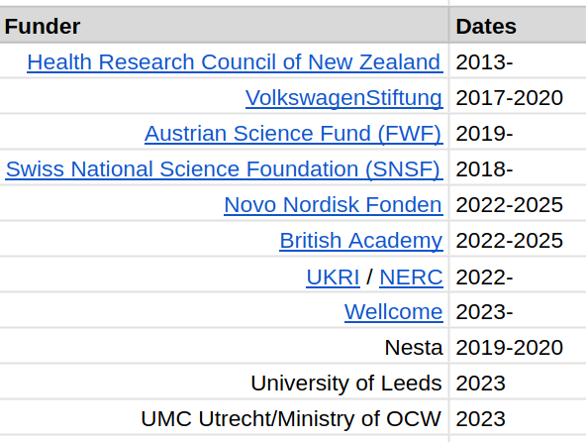
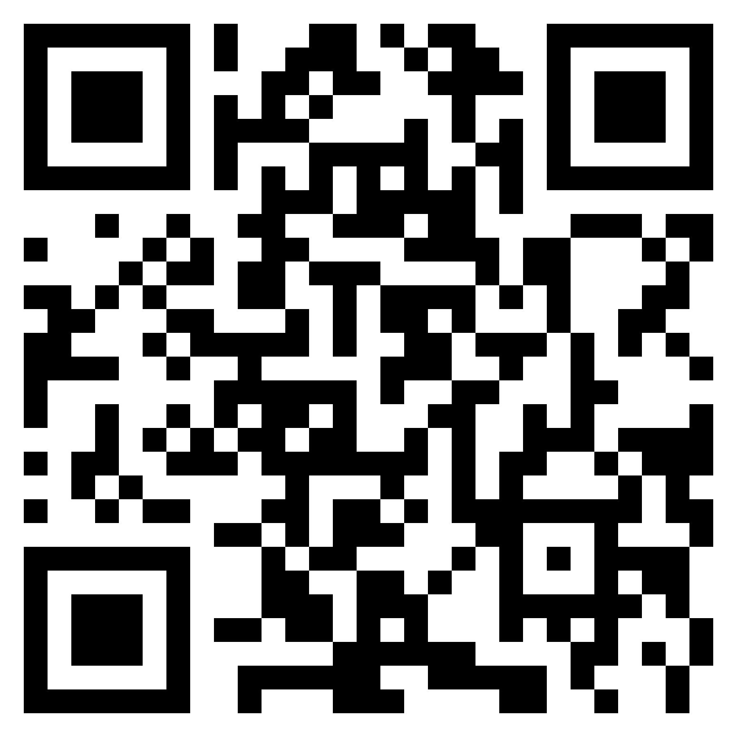
Partial Randomisation Trials Catalogue
bit.ly/PRtrials

Slide 12
Desk Rejection Shadow Experiment
Can agency staff predict those proposals with the least likelihood of success?
a shadow experiment, not an intervention
supports optimal use of external review
UKRI leading participation
recruiting schemes which will complete by end of 2026
Enquiries:
Josie Coburn,
Research Fellow in Metascience,
Research on Research Institute
josie.coburn@ucl.ac.uk

Slide 13
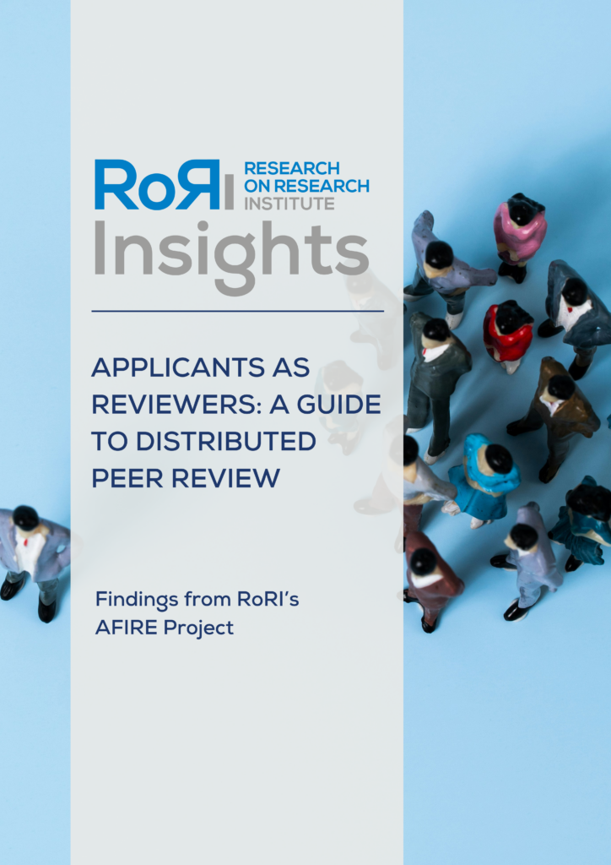

Evaluating Distributed Peer Review at the Volkswagen Foundation Anna Butters, Melanie Benson Marshall, Tom Stafford & Stephen Pinfield (Research on Research Institute and University of Sheffield); Hanna Denecke, Alexander Bondarenko, Barbara Neubauer, Robert Nuske & Pierre Schwidlinski (Volkswagen Foundation)
Distributed Peer Review

Slide 14
AI in Grantmaking

Slide 15




You: teams from 3 4 funders
= 4 missions
Introduce yourself in the chat!
+ add your organisation to your zoom name please

Slide 16
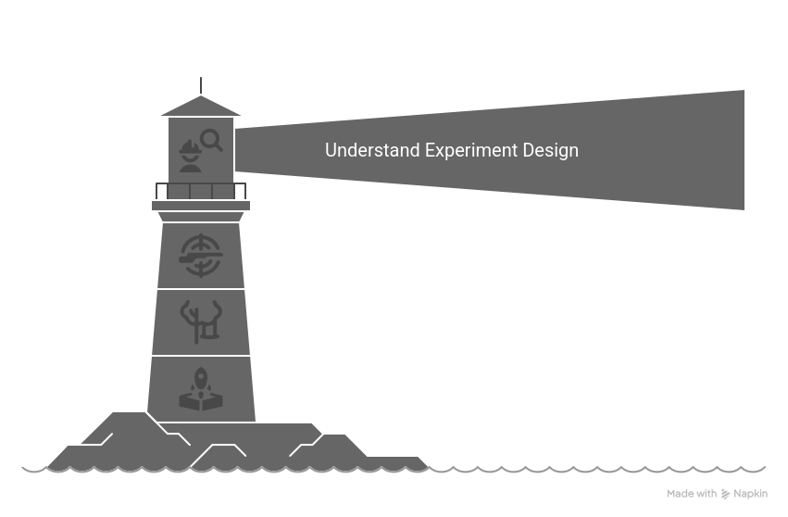
Our Mission!
Together we will wrestle with the particular discipline that experiment design forces: how to plan an investigation that is both focussed enough to provide a clear outcome, but also general enough to provide relevant evidence for future action. The ambition is that everyone will finish the sessions some steps closer to the goal of launching new experiments in the space of evaluating the use of AI in research funding.

Slide 17
Roadmap
DATE | FOCUS
Nov 12 | Workshop 1: Why experiment with AI? Lessons from the GRAIL project, understanding the risks and benefits of experiments
Nov 19 | - one to one slots : bespoke coaching on developing experiments
Nov 26 | Workshop 2: Examples of experiments with AI Discussion of case studies, experiment design
Dec 3 | - one to one slots : bespoke coaching on developing experiments
Dec 11 | Workshop 3: Your experiment with AI Pitches for new experiments & feedback, advocating for experiments in your organisation

Slide 18
Some logistics
Emails and Calendar invites: Let Tom know if anyone missing these
Recordings: The talks (only) will be recorded
Discussions are under the Chatham House Rule:
"anyone who comes to a meeting is free to use information from the discussion, but is not allowed to reveal who made any particular comment."
Coaching sessions: Lead for your group has been in contact / will be soon
Essential info: google folder

Slide 19
Timetable for today (UTC+11)
1600 Introductions, Logistics
1610 GRAIL reflections (Youyou Wu) 1625 Breakout groups 1640 Plenary
1650 (break)
1700 Why experiments? (Tom Stafford)
including discussion
1750 END

Slide 20

Welcome From Youyou Wu
Associate Professor in Psychology
University College London (UCL)
https://www.drwuyouyou.com/
Research Fellow
Research on Research Institute
https://researchonresearch.org/

Slide 21



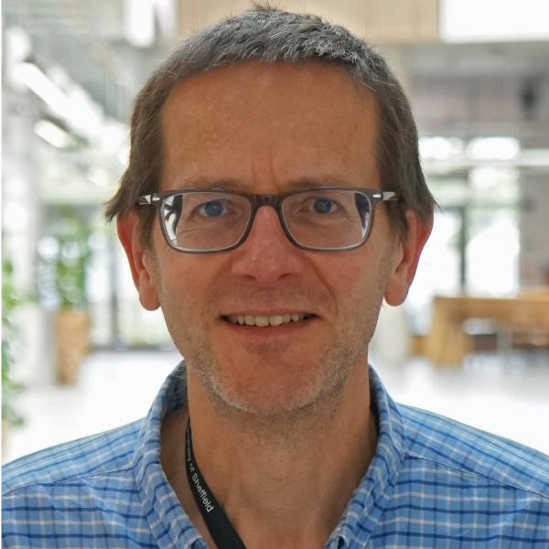

GRAIL reflections
GRAIL = Getting responsible about AI and machine learning (ML) in research funding and evaluation
A RoRI project running from 2023 to 2025
Goal: Understand how funders use AI/ML and build shared practices
Who:
35 delegates from 13 research funders
4 researchers

Slide 22
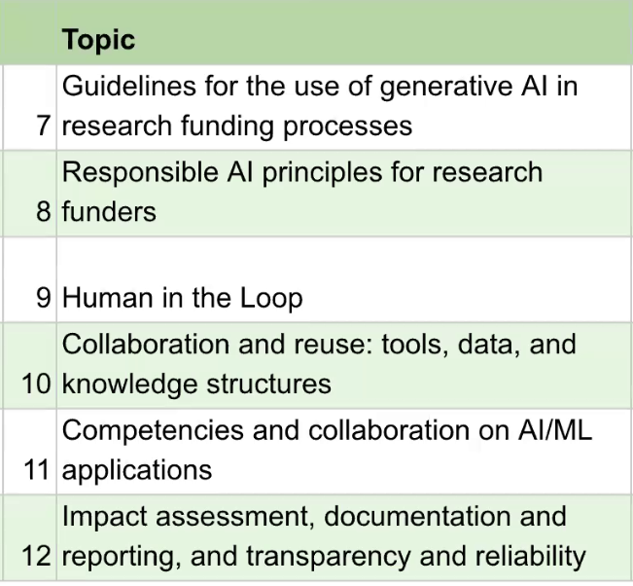
GRAIL activities
13 virtual workshops
Presentations / case studies
Q&A
Group discussions

Slide 23
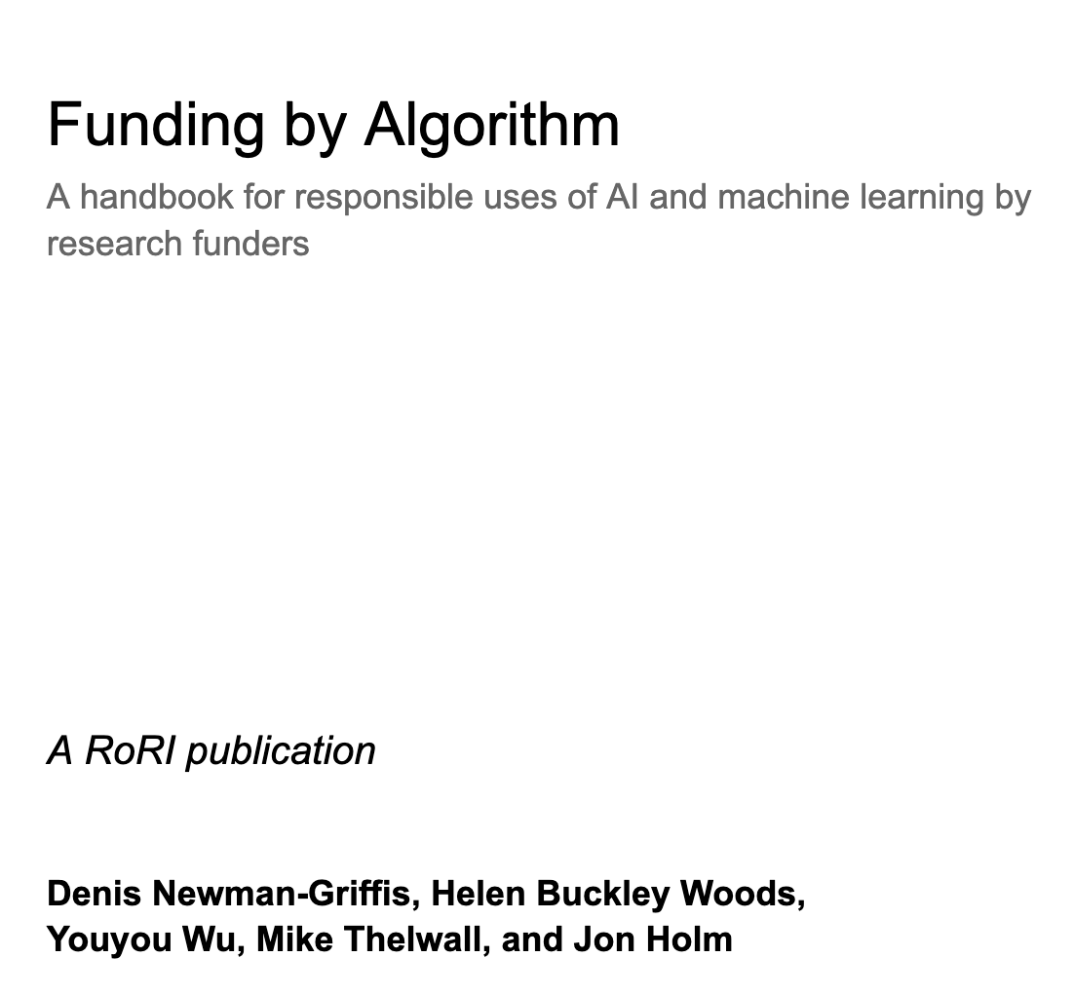

GRAIL outputs
The GRAIL Handbook [link]
Launched online on 20th of June, 2025
Launched in-person at the Metascience conference 2025

Slide 24
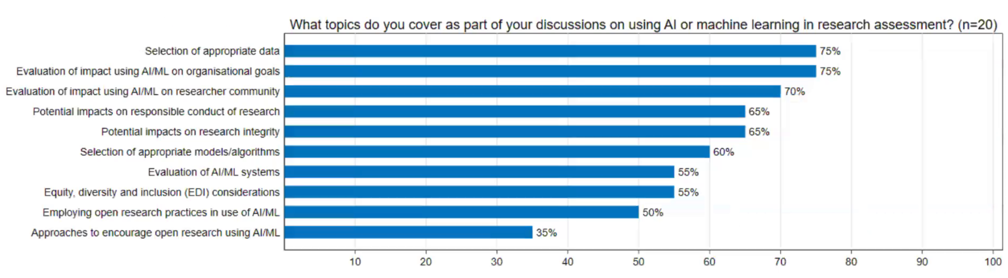
GRAIL outputs
A curated library of AI/ML use cases
Survey: experiences with AI/ML

Slide 25
GRAIL insights

Slide 26
GRAIL insights: a wide range of AI use cases
Peer review
Handling applications
Tracking and evaluating research outputs
Assisting applicants

Slide 27
GRAIL insights: AI use cases
Peer review
Matching proposals to reviewers [Handbook case study 1]
Evaluating the quality of reviewers’ comments
Summarising and integrating reviewer comments

Slide 28
GRAIL insights: AI use cases
Handling applications
Screening and prioritising applications [Handbook case study 2]
Automatic tagging of proposals for topic/theme/SDGs
Summarising / translating proposals
Detecting duplicate / similar applications
Verify eligibility

Slide 29
GRAIL insights: AI use cases
Tracking and evaluating research outputs
Linking funded grant and research publications [Handbook case study 3]
Linking funded grant and research impacts (patent/policy/media) [Handbook case study 4]
Quality assessment of research publications [Handbook case study 5]

Slide 30
GRAIL insights: AI use cases
Assistance for applicants
Chatbot for understanding funding calls
Proposal writing assistant
Proposal review assistant
Self-evaluation of proposal

Slide 31
GRAIL insights: AI/ML development
AI/ML development cycles
Prototyping first version, see if it can be done
Pilot testing apply to a small set of cases
Beta testing and refinement gradually roll out to users
Organisational deployment fully deployed, user training and monitoring

Slide 32
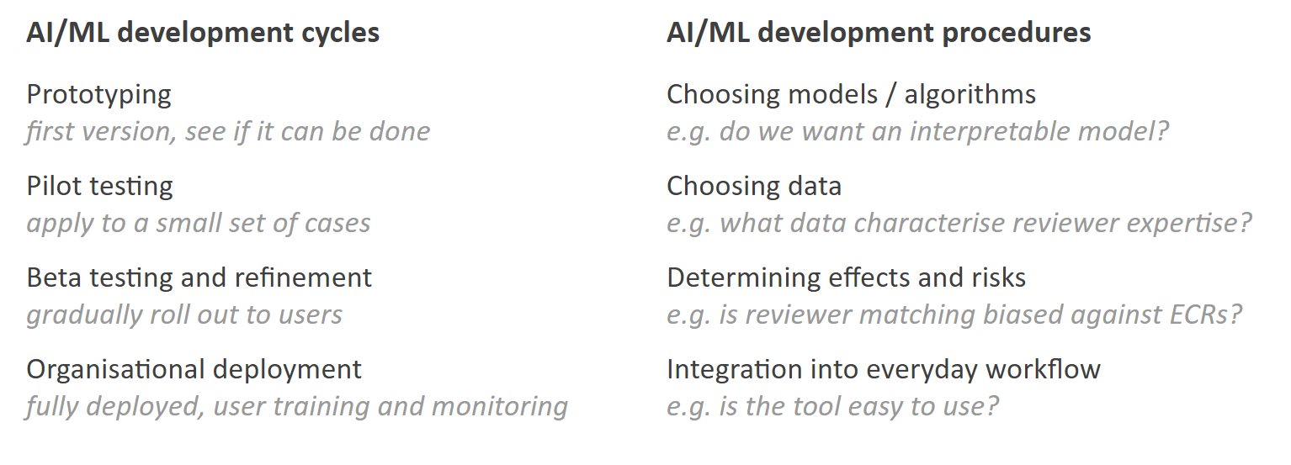
GRAIL insights: AI/ML development
AI/ML development procedures
Choosing models / algorithms e.g. do we want an interpretable model?
Choosing data e.g. what data characterise reviewer expertise?
Determining effects and risks e.g. is reviewer matching biased against ECRs?
Integration into everyday workflow e.g. is the tool easy to use?

Slide 33
GRAIL insights: AI/ML development
AI/ML development cycles
Prototyping first version, see if it can be done
Pilot testing apply to a small set of cases
Beta testing and refinement gradually roll out to users
Organisational deployment fully deployed, user training and monitoring
AI/ML development procedures
Choosing models / algorithms e.g. do we want an interpretable model?
Choosing data e.g. what data characterise reviewer expertise?
Determining effects and risks e.g. is reviewer matching biased against ECRs?
Integration into everyday workflow e.g. is the tool easy to use?

Slide 34
GRAIL insights: AI/ML development
Evaluation and experimentation can happen at all the stages, across all the procedures
Notes:
for high stake

Slide 35
GRAIL insights: evaluation and experimentation
Why do formal experiments?
Validate the AI/ML tools
Align with organisational goals
Gain trust and support from applicants / institutions / the public
Set standards for the wider research community
Notes:
Validate the AI/ML tools for your own organisation, and other funders that want to use it existing processes

Slide 36
GRAIL insights: evaluation and experimentation
Why do formal experiments?
Validate the AI/ML tools
Align with organisational goals
Gain trust and support from applicants / institutions / the public
Set standards for the wider research community
What to experiment on?
Does the AI/ML tool work?
Not just “does it work”, but “How, for whom, and with what consequences”?
AI implementation is never “done”: Continuous monitoring, refinement, and feedback loops

Slide 37
GRAIL insights: evaluation and experimentation
Just like how you would evaluate any other non-AI processes
Why do formal experiments?
Validate the AI/ML tools
Align with organisational goals
Gain trust and support from applicants / institutions / the public
Set standards for the wider research community
What to experiment on?
Does the AI/ML tool work?
Not just “does it work”, but “How, for whom, and with what consequences”?
AI implementation is never “done”: Continuous monitoring, refinement, and feedback loops

Slide 38
GRAIL insights: evaluation and experimentation
GRAIL has seen some excellent examples of experiments (a few among the participants)
A few suggested areas for evaluation in the handbook
AI in reviewer matching
AI in producing peer review reports
AI for prioritising funding applications
AI in research assessment exercises
AI for applicant self-assessment
AI for navigating funding resources
AI in strategic planning

Slide 39
GRAIL insights
More systematic experiments with AI/ML tools is needed
Small, focused experiments will help us move beyond anecdotes
Potential for multi-funder collaboration on experiments

Slide 40
Stop recording

Slide 41
Breakout group discussion
Topic: Your experiences working on AI/ML applications Duration: 10 minutes Structure:
Going around each funder:
What AI/ML application have you worked on?
At what stage are you with it? (prototyping, pilot testing, beta testing and refinement, full deployment)
Where are you with experimentation? Tag yourself with the following: Experimenter (have done experiments to evaluate the AI/ML tool) Designer (have designed experiments, with implementation soon to follow) Thinker (thinking about experimenting, but are yet to take further steps)
For each funder, the aim is to have a short sentence to share at the end explaining what experiments you have done/designed/thought about.
Notes:
evaluation and experimentation can take many forms

Slide 42

Plenary:
Please share in the chat:
a short sentence explaining what experiments you have done/designed/thought about

Slide 43
Break
Start again on the hour

Slide 44
One sentence reports: A*STAR
ASTAR:
: we are basically still at thinker stage with some designing. mainly for peer review, chatbot. interested in tracking outcomes too but challenge with access to data
Chatbot for approval processes FAQ, use of AI to mitigate governance risks, and lessen administrative burden.

Slide 45
One sentence reports: NHMRC
We have implemented an ML tool to allocate applications to peer reviewers (implemented in a section of our department). We are also looking into AI to categorise disease types for research that we fund. Finally, looking into how AI can assist with automating qualitative case studies.

Slide 46
DST
Hi everyone, We are just aspiring to use the AI/ML tools and have so far done some experimentation for first level screening of the proposals for evaluation. Look forward to experiment the potential tools or proven experiments for effective research assessment.

Slide 47
One sentence reports:ARC
JW: No experience with undertaking AI experiments. More interested in application of existing proven technologies.
FNT: Currently experimenting with LLMs to understand funding by topics of interest not otherwise easily classifiable. Other early investigation of the application of NLP to develop metrics and indicators of research performance.

Slide 48
Start recording

Slide 49
Feedback from pre-workshop survey
Current focus
applying AI for internal grant processes.
distributed peer review
AI Allocation of applications to peer reviewers.

Slide 50
Sprint v1.0 - N America and European funders
AI in reviewer matching | 3.8
AI in peer reviewing | 3.5
AI for prioritising funding applications | 3.3
AI in research assessment exercises | 3.2
AI for applicant self-assessment | 3.2
AI for navigating funding resources | 3.0
AI in strategic planning | 2.8

Slide 51
Sprint v2.0 - Asia / Pacific
AI in reviewer matching
AI in peer reviewing
AI for prioritising funding applications
AI in research assessment exercises
AI for applicant self-assessment
AI for navigating funding resources
AI in strategic planning

Slide 52
ideal outcomes for you of these sessions?
Peer learning: to learn how funding agencies are using AI for grant processes
To better understand the potential use of AI in strengthening the research funding
Not: technical implication aspects.

Slide 53
Why experiment with AI?
Better evidence: Why innovation & observation alone are not enough

Slide 54
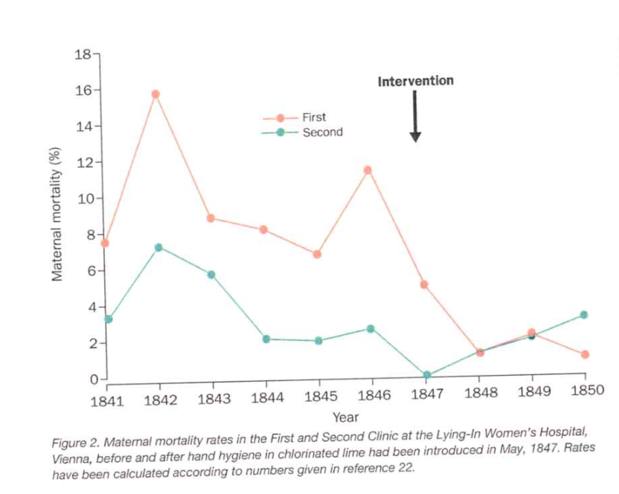
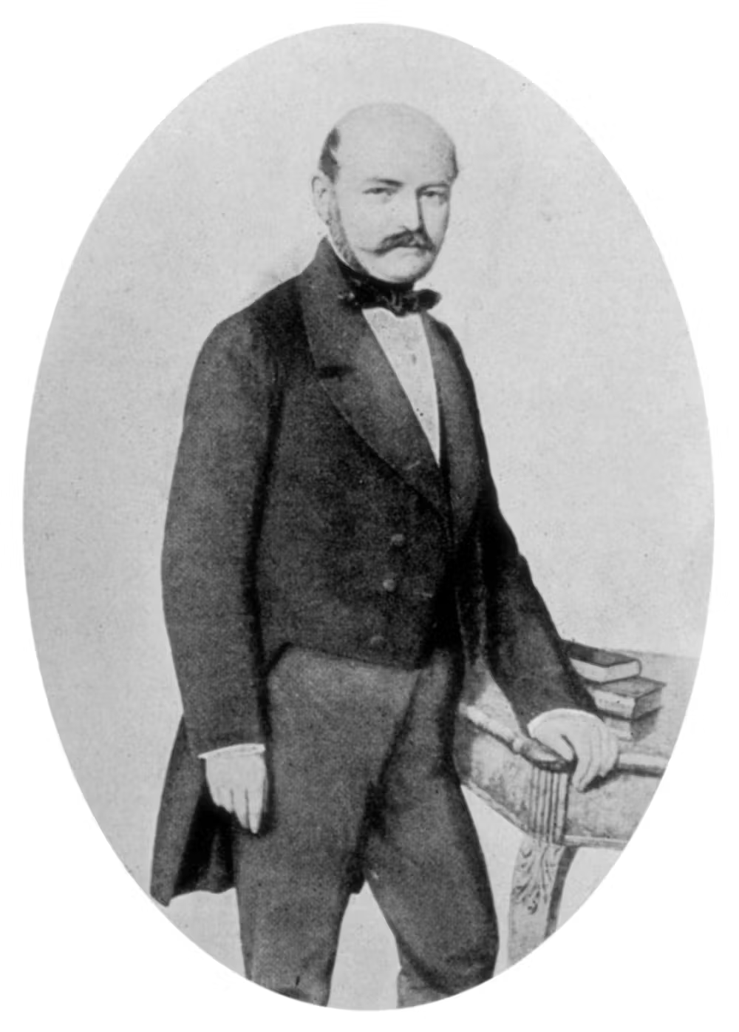
Evidence > Experience
Ignaz Philipp Semmelweis (1818-1865) Universal Images Group via Getty Images
Pittet, D., & Boyce, J. M. (2001). Hand hygiene and patient care: pursuing the Semmelweis legacy. The Lancet Infectious Diseases, 1, 9-20.

Slide 55
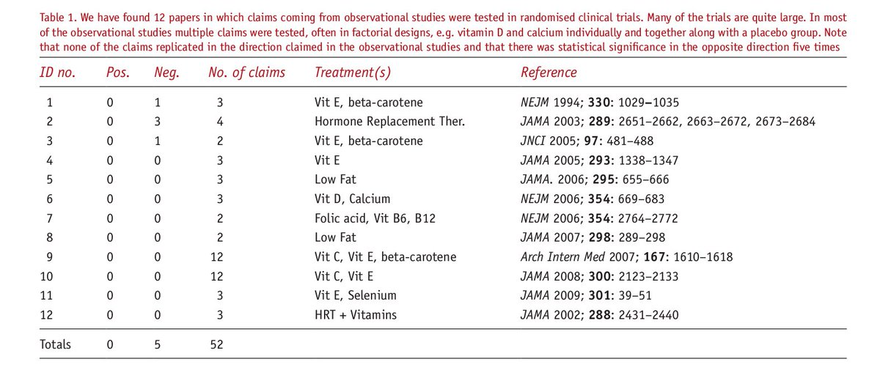
Experiments > Observation
out of 52 claims about nutrition based on observational studies, none replicated in randomised trials (and 5 trials showed effects in the opposite direction)
Deming, data and observational studies (2011)
https://rss.onlinelibrary.wiley.com/doi/epdf/10.1111/j.1740-9713.2011.00506.x

Slide 56
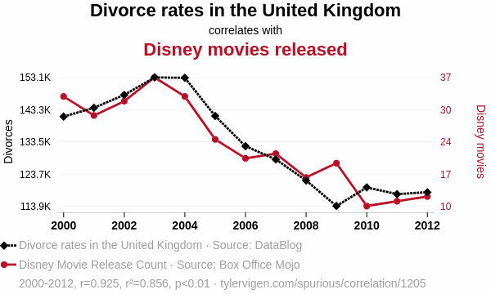
Limits to observation
Spurious correlations
Omitted variables
(confounding)
Out of sample

Slide 57
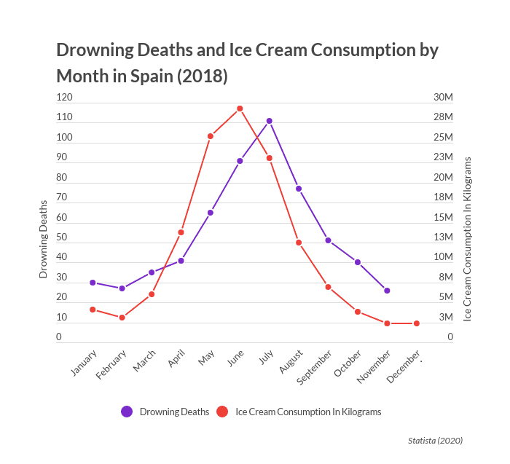
Limits to observation
Spurious correlations
Omitted variables
(confounding)
Out of sample

Slide 58
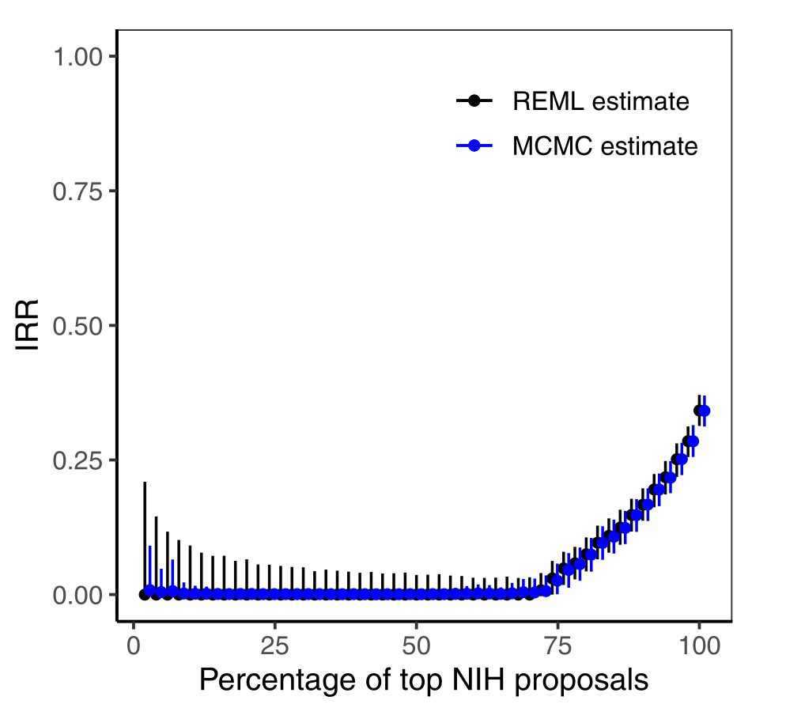
Limits to observation
Spurious correlations
Omitted variables
(confounding)
Out of sample
Erosheva EA, Martinková P, Lee CJ. When zero may not be zero: A cautionary note on the use of inter- rater reliability in evaluating grant peer review. J R Stat Soc Series A. 2021;00:1–16. https://doi.org/10.1111/rssa.12681

Slide 59
Limits to observation
Spurious correlations
Omitted variables
(confounding)
Out of sample
Erosheva EA, Martinková P, Lee CJ. When zero may not be zero: A cautionary note on the use of inter- rater reliability in evaluating grant peer review. J R Stat Soc Series A. 2021;00:1–16. https://doi.org/10.1111/rssa.12681

Slide 60
What “Experiment” means
A change or difference ->
A commitment to evaluate
A plan to evaluate
A commitment to share the evaluation
Notes:
methodological plural, but retain the capacity to be surprised - and that means capturing expectations

Slide 61
Our definition of experiment
Principled: a research design that allows inference about what causes what (before/after, shadow experiments, true experiment/RCT)
Planned: primary outcome measure and analysis plan declared in advance
Public: a commitment to sharing the results regardless of outcome

Slide 62
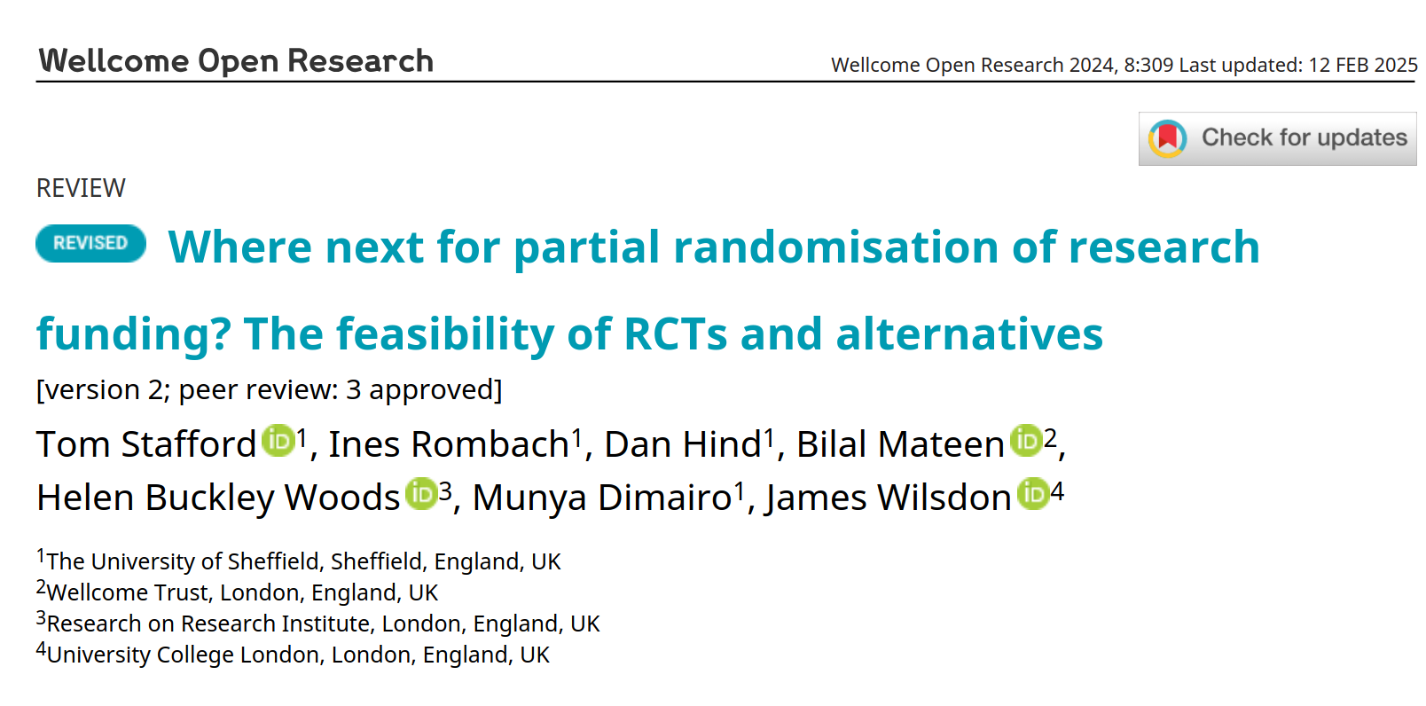
Principled
https://wellcomeopenresearch.org/articles/8-309/

Slide 63
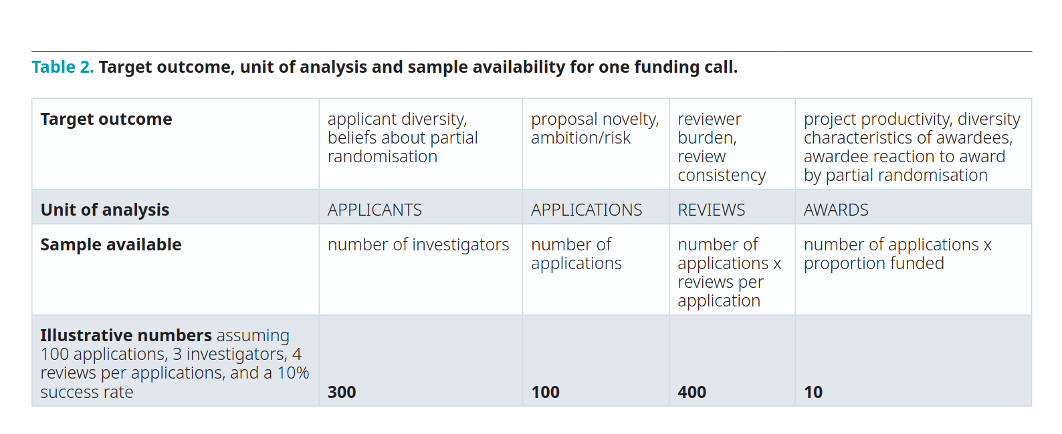

Slide 64

Planned
Prespecification - in as much detail as possible:
- The research question(s)
- The primary outcome measure(s)
- What you’re going to do (which interventions, who with / which data)
- Test(s) which will determine success

Slide 65
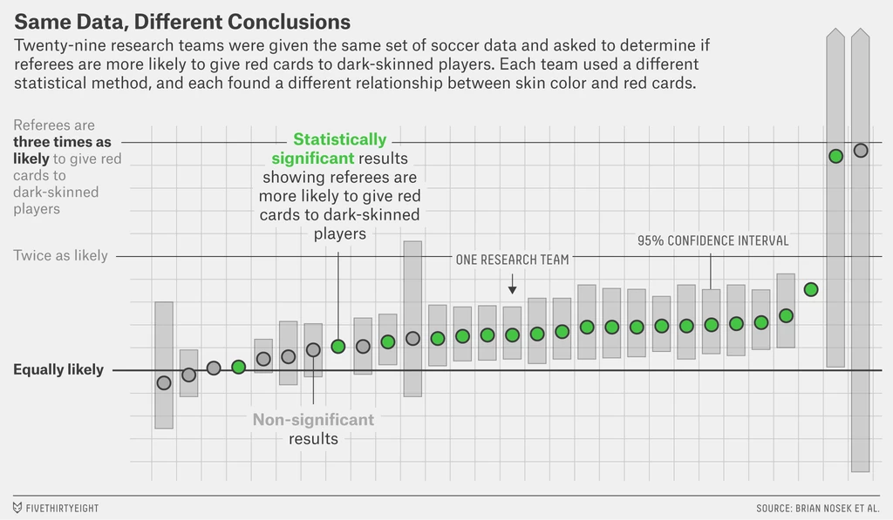
Researcher degrees of freedom
“These findings suggest that significant variation in the results of analyses of complex data may be difficult to avoid, even by experts with honest intentions.”
Silberzahn, R. et al (2018). Many analysts, one dataset: Making transparent how variations in analytical choices affect results. Advances in Methods and Practices in Psychological Science, 1(3), 337-356

Slide 66
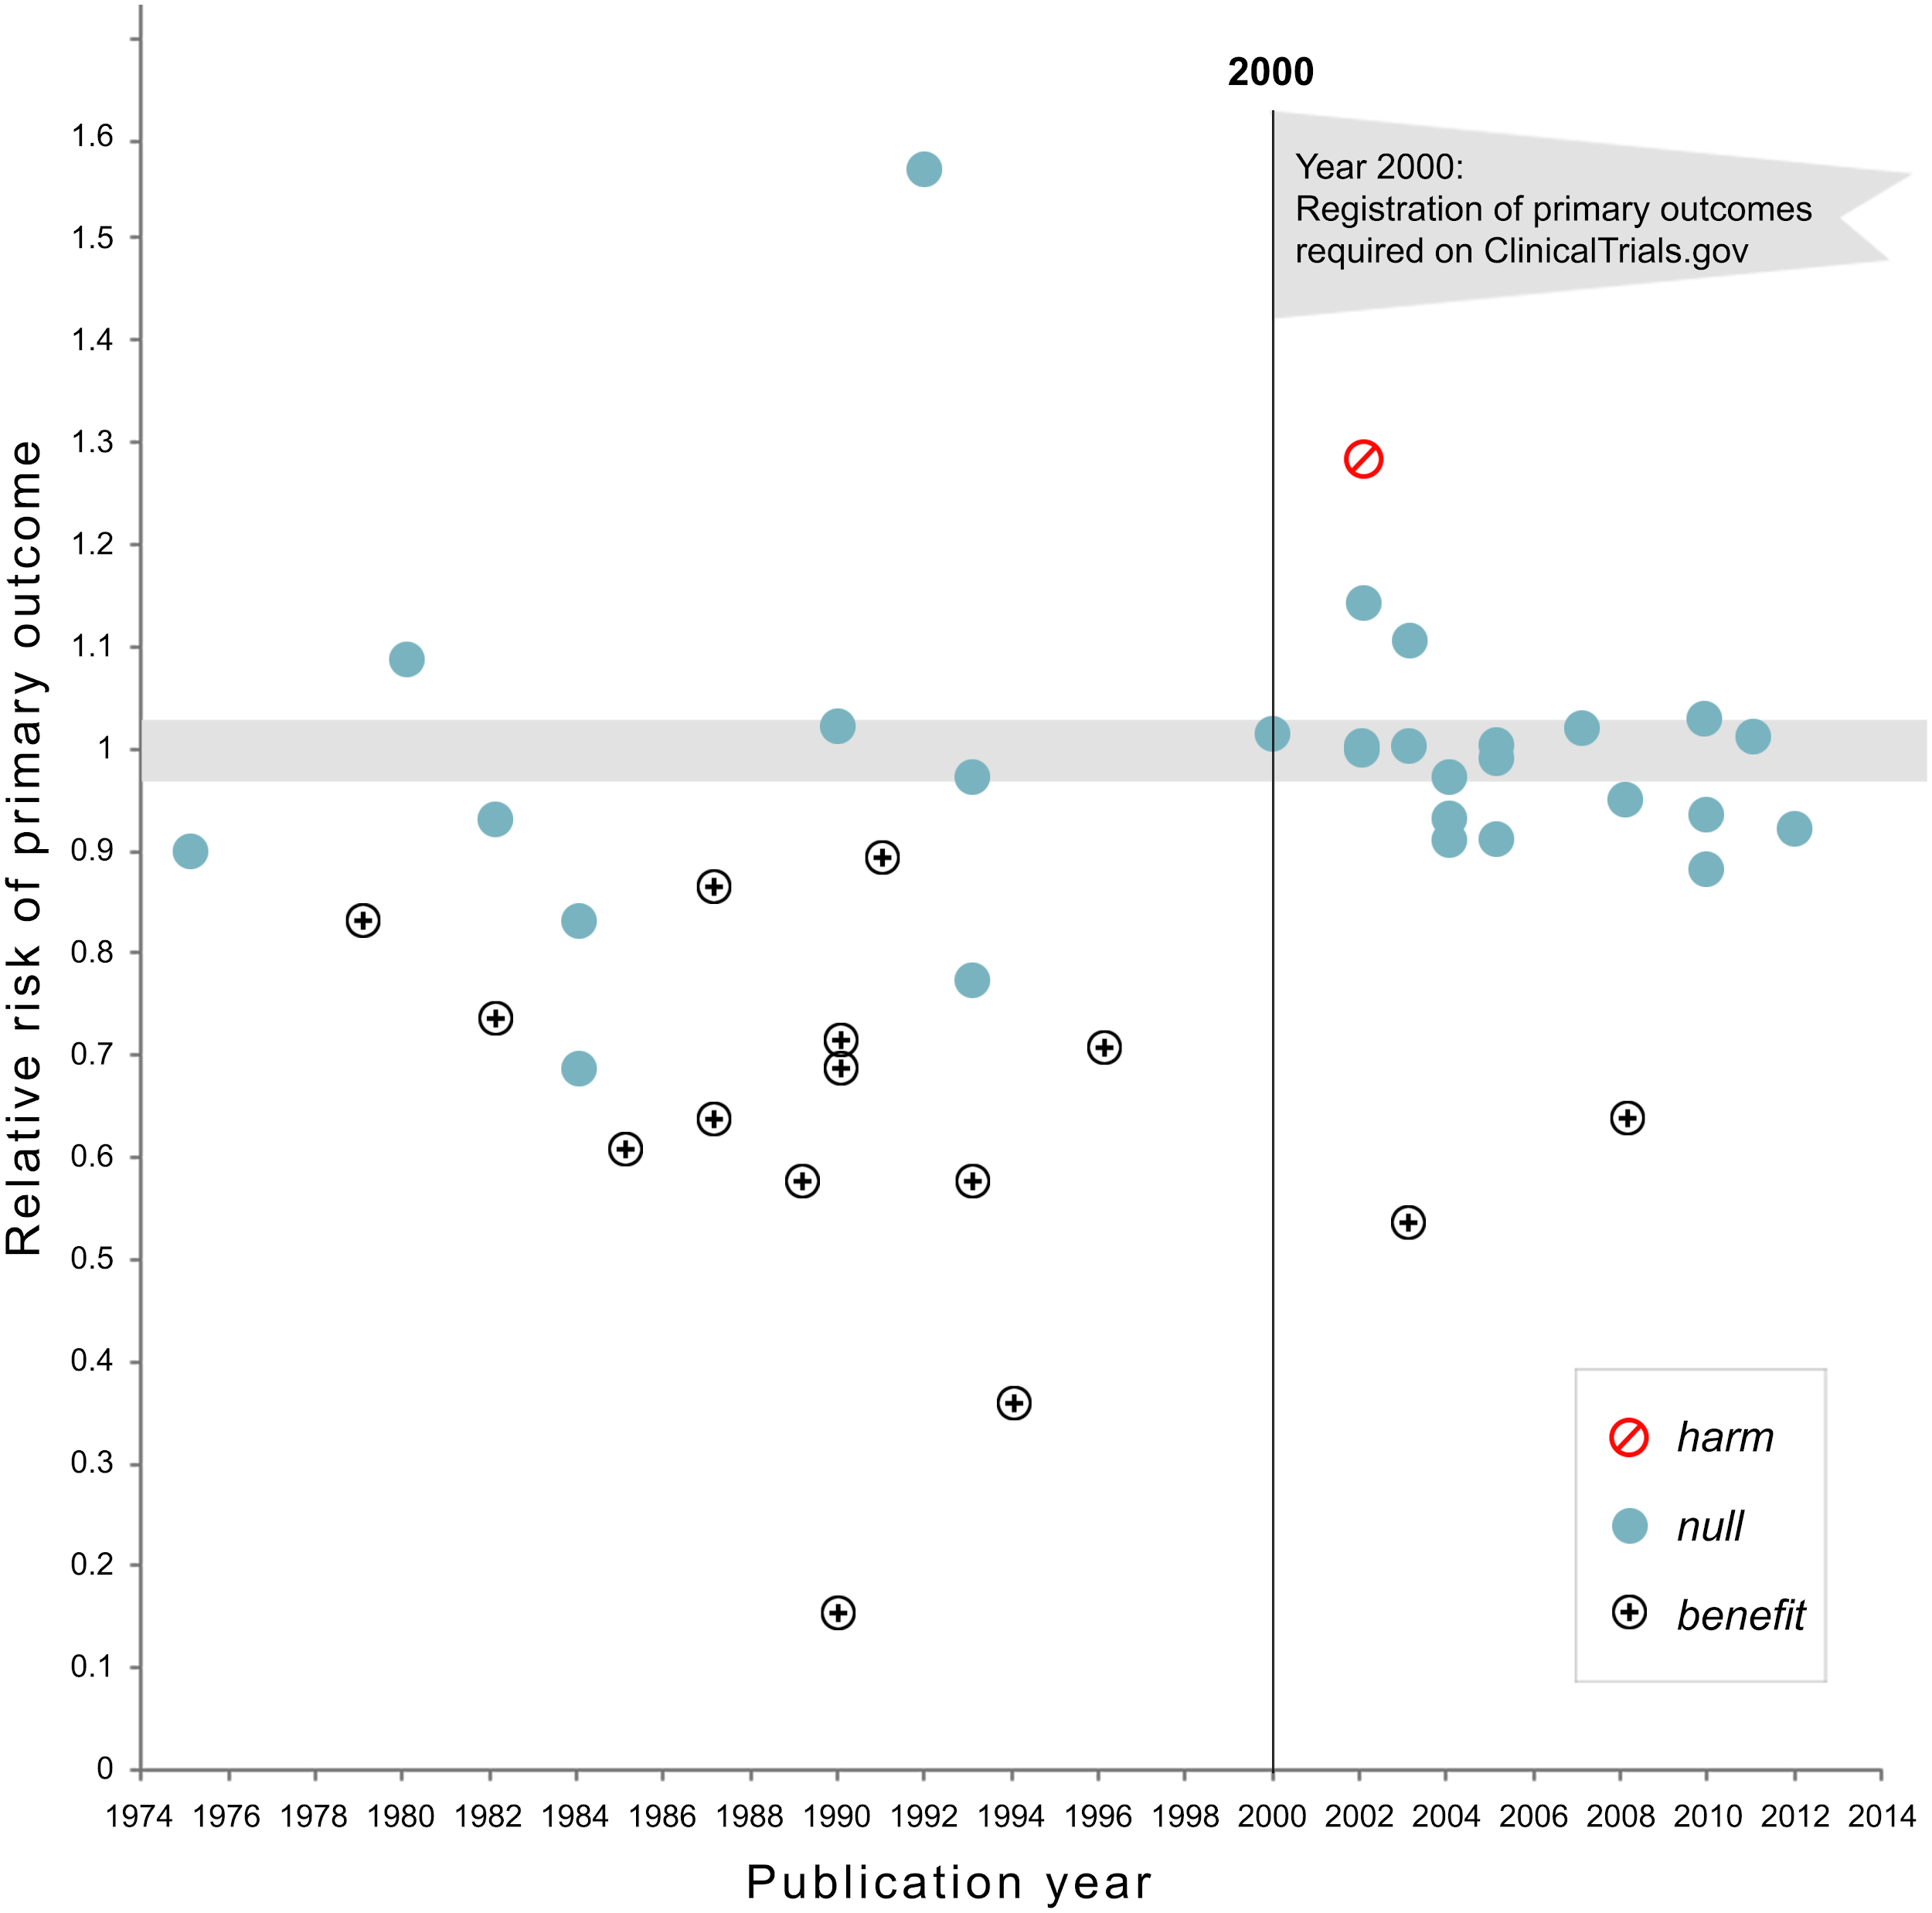
Analytic flexibility
can mislead
Kaplan, R. M., & Irvin, V. L. (2015). Likelihood of null effects of large NHLBI clinical trials has increased over time. PloS one, 10(8), e0132382. https://journals.plos.org/plosone/article?id=10.1371/journal.pone.0132382

Slide 67

Public: Sharing is essential
Contribute to knowledge commons
Support future evidence synthesis
Advertise your work
Transparency of signal of credibility
Threat of scrutiny forces rigour
Learning organisations - requires bravery!
Image: Puzzle Pieces, CC-BY by M Ryan, US

Slide 68
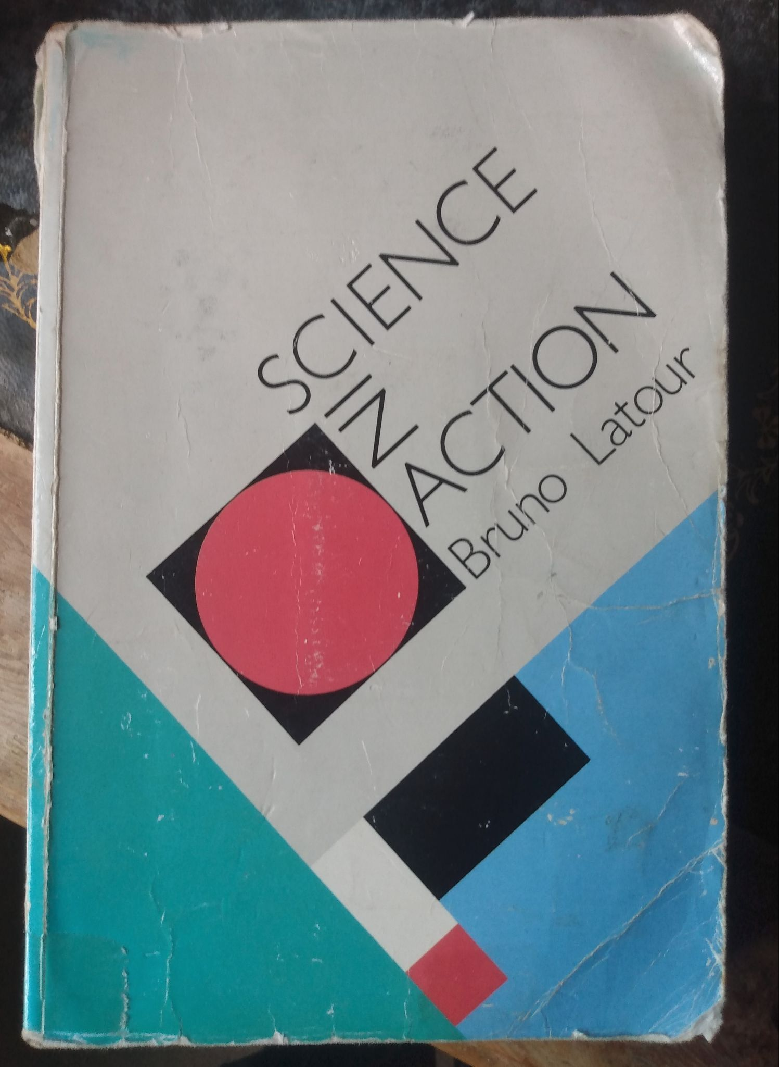
When to experiment
Show values
Build learning capacity: how to explore?
Resolve uncertainty : how to exploit?
Propagandise change

Slide 69
Why AI specifically requires experiments
AI is novel & changing - our intuitions are poorly calibrated
Specific areas of uncertainty
- Fluency
- Stochasticity
- Hallucinations
- Inscrutability
- Bias

Slide 70
“The Art of the Possible”
Interesting
Feasible
!

Slide 71

Good outcome measures
A part of the fresco “Triumph of Galatea,” created by Raphael around 1512 for the Villa Farnesina in Rome. Art Images via Getty Images
Notes:
anecdote about dating site data science

Slide 72
IDEA
SOLUTION
IDEA
HYPOTHESIS
Notes:
We often explain innovation as: having a new idea (of a solution or how to improve and reform public services), that is successfully implemented and as an outcome generates (public) value.
To be perfectly clear on this: innovation is not just about having ideas. The challenging part is in successfully implementing them.
Ideas are never born fully formed they are always impartial and imperfect, they need to be refined and developed.^{[1]}
Main purpose of experimentation is to accelerate learning!
If we want better public outcomes for the complex challenges governments are facing, we need governments that are more agile and experimental. This means that governments should systematically test out ideas at an early stage and at small scale before vast amounts of money, time and other resources have been spend and where there is room to learn and find out what works and what doesn’t. Strengthening the capacity to experiment and learn from failure should help governments to better understand the nature of the problem, identify cognitive or social biases, explore new solution spaces.
The trick is… how can you maximise/accelerate learning for minimum effort and costs.
To find out if an idea is good and further improve it, is to test it, find out what works and what not, and support decisions with evidence.

Slide 73

A note about feasibility vs testing
What are criteria for evaluation?
The imaginative leap is to ask “what does this capability do to your organisation?”
Not, “how do we get it to work”, but “how would we test how well it works”?

Slide 74
If … then…
If [we do this] then [this will happen]
action/intervention
observable/measurable effect

Slide 75
Breakout groups until h40 mins
If … then…
If [we do this] then [this will happen]
Reformulate AI use-case from first break out as an “if-then” statement
“If X then Y”
“If we could use AI to more quickly identify reviewers then we could make awards more quickly after application”
Notes:
Here the idea is to get them to reflect on the assumption behind their ‘idea’ and how to turn in into a testable hypothesis. Usually it’ll be necessary to break it down into small assumptions/hypotheses to be tested.

Slide 76
Stop recording

Slide 77
Plenary: 1745 UTC+11
i) THEN : What targets did we have for our use of AI?
ii) IF : What challenges did we identify for interventions?

Slide 78
Next time
Homework: Which ONE use of AI in your organisation is easiest to test if it is working (and HOW). Formulate as an IF-THEN statement.
Session 1 feedback survey
Pre-session activity for session 2: coming soon!
One-to-one coaching slot: 19th November (or anytime that week)
Next workshop: 26th November: case studies in experiments with AI

Slide 79

Bendiscioli, Sandra; Firpo, Teo; Bravo-Biosca, Albert; Czibor, Eszter; Garfinkel, Michele; Stafford, Tom; et al. (2022):
The experimental research funder’s handbook (Revised edition, June 2022, ISBN 978-1-7397102-0-0).
Research on Research Institute. Report. https://doi.org/10.6084/m9.figshare.19459328.v2
These slides:
http://bit.ly/tom-talks

Slide 80
Further resources on experimentation
Bendiscioli, Sandra; Firpo, Teo; Bravo-Biosca, Albert; Czibor, Eszter; Garfinkel, Michele; Stafford, Tom; et al. (2022): The Experimental Research Funder’s Handbook (Revised edition, June 2022, ISBN 978-1-7397102-0-0). Research on Research Institute.
Munafò, M. R., Nosek, B. A., Bishop, D. V., Button, K. S., Chambers, C. D., Percie du Sert, N., ... & Ioannidis, J. (2017). A manifesto for reproducible science. Nature human behaviour, 1(1), 1-9. https://doi.org/10.1038/s41562-016-0021
Why observation is not enough, even if you have sophisticated analysis:
Gordon, B. R., Zettelmeyer, F., Bhargava, N., & Chapsky, D. (2019). A comparison of approaches to advertising measurement: Evidence from big field experiments at Facebook. Marketing Science, 38(2), 193-225.
Westfall, J., & Yarkoni, T. (2016). Statistically Controlling for Confounding Constructs Is Harder than You Think. PLOS ONE, 11(3), e0152719. https://doi.org/10.1371/journal.pone.0152719

Slide 81





Join the conversation
researchonresearch.org
@RoRInstitute

Slide 82

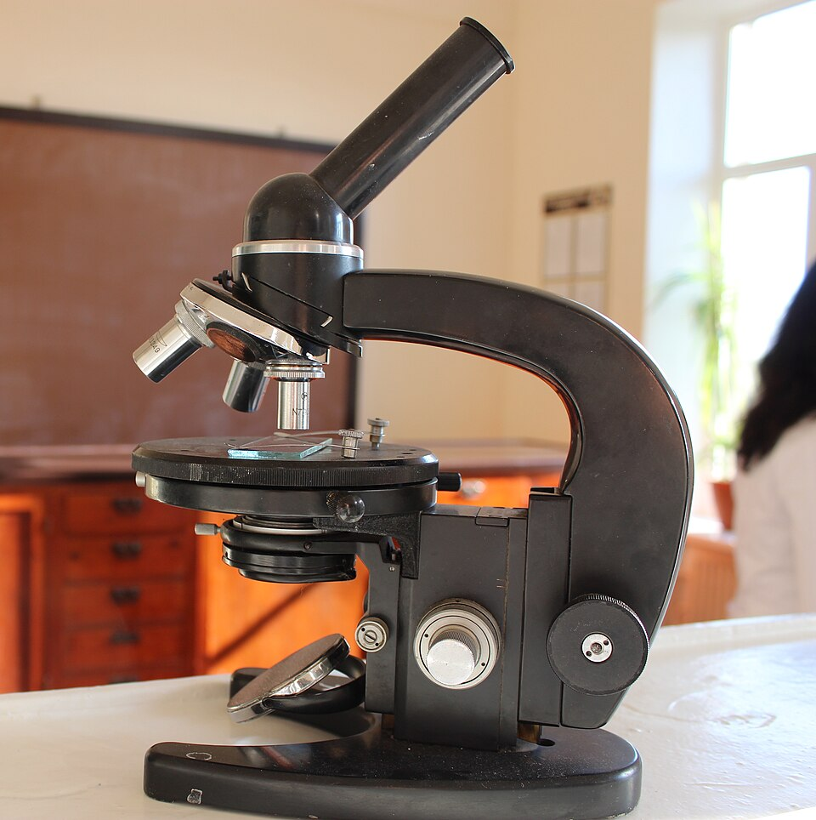
Assays and microscopes
Yes/No
but is it the right question
Close view
but what are you looking for?
Image: CC Wikimedia

Slide 83

Just designing experiments is valuable

